Slide 1

Application of topological data analysis in biomechanics
2020. 09. 04
Sangman Jung , Kyungsoo Kim
Kyung Hee University

Slide 2
Contents
Introduction
Topological data analysis (TDA)
Method
Application
Summary

Slide 3
Introduction
What is the topological data analysis (TDA):
The recently proposed data analysis method in computational topology.
It requires algebraic topology and programming skills
Why we use this:
This method finds topological structure and extracts some topological features.
It can be effective in finding hidden features of raw data that cannot be found with conventional data analysis methods.
Purpose:
To obtain topological features of biomechanical data using TDA.
To quantify similarities or dissimilarities between subjects.

Slide 4
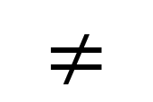
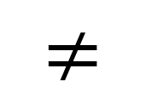
Topological data analysis (TDA)
Basic flow
A B C
Raw dataset
Find topological structures
$$≠$$
$$≠$$
Extract topological features
“ Two shapes can be distinguished by examining their holes. ”
reference : Walker, B. (2008, May). Using persistent homology to recover spatial information from encounter traces. In Proceedings of the 9th ACM international symposium on Mobile ad hoc networking and computing (pp. 371-380).

Slide 5

Topological data analysis (TDA)
Basic flow
A B C
Raw dataset
“ The number of k-dimensional holes in the space. ”
Find topological structures
$$≠$$
$$≠$$
Betti Number $β_{k}$
Extract topological features
“ Two shapes can be distinguished by examining their holes. ”
reference : Walker, B. (2008, May). Using persistent homology to recover spatial information from encounter traces. In Proceedings of the 9th ACM international symposium on Mobile ad hoc networking and computing (pp. 371-380).

Slide 6

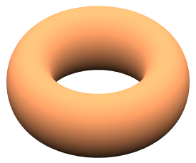
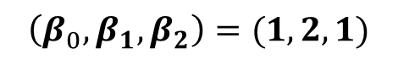
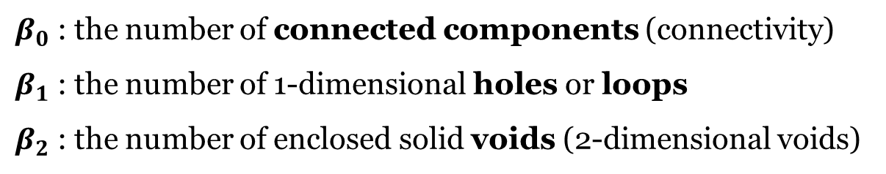
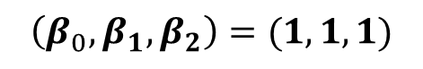
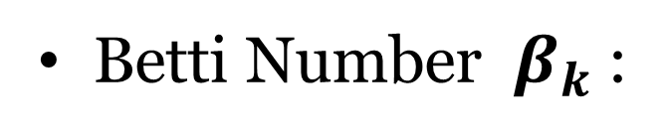
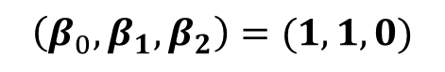
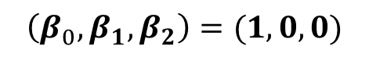
Topological data analysis (TDA)
Betti Number $β_{k}$:
$β_{0}$ : the number of connected components (connectivity)
$β_{1}$ : the number of 1-dimensional holes or loops
$β_{2}$ : the number of enclosed solid voids (2-dimensional voids)
(intuitively)
$$\left(β_{0},β_{1},β_{2}\right)=(1,0,0)$$
$$\left(β_{0},β_{1},β_{2}\right)=(1,1,0)$$
$$\left(β_{0},β_{1},β_{2}\right)=(1,1,1)$$
$$\left(β_{0},β_{1},β_{2}\right)=(1,2,1)$$
reference : Moon, C., Giansiracusa, N., & Lazar, N. A. (2018). Persistence terrace for topological inference of point cloud data. Journal of Computational and Graphical Statistics, 27(3), 576-586.

Slide 7
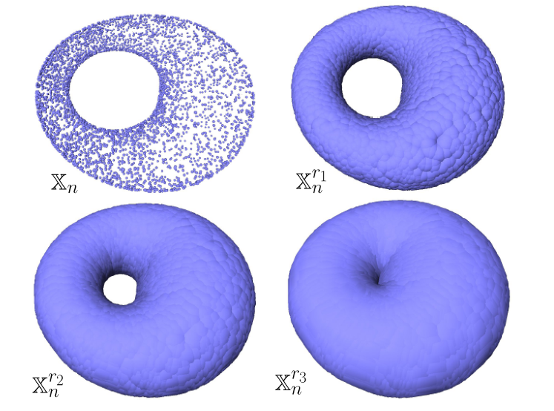
Topological data analysis (TDA)
Feature extraction
Figures in this slide: Chazal, F., & Michel, B. (2017). An introduction to Topological Data Analysis: fundamental and practical aspects for data scientists. arXiv preprint arXiv:1710.04019.

Slide 8
Topological data analysis (TDA)
Feature extraction
Point cloud
Figures in this slide: Chazal, F., & Michel, B. (2017). An introduction to Topological Data Analysis: fundamental and practical aspects for data scientists. arXiv preprint arXiv:1710.04019.

Slide 9
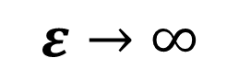

Topological data analysis (TDA)
Feature extraction
Point cloud
$$ε→∞$$
$$ε$$
Figures in this slide: Chazal, F., & Michel, B. (2017). An introduction to Topological Data Analysis: fundamental and practical aspects for data scientists. arXiv preprint arXiv:1710.04019.

Slide 10

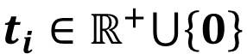

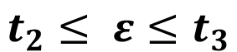
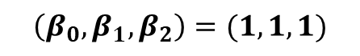

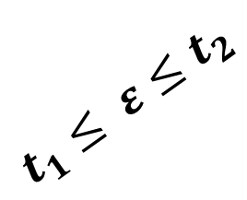
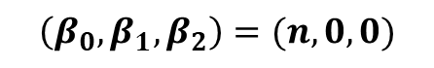
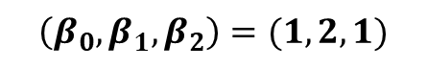
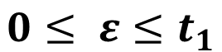

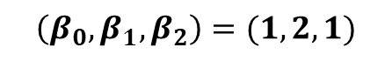
Topological data analysis (TDA)
Feature extraction
$$ε=0$$
$$ε=t_{1}$$
$$0≤ ε≤t_{1}$$
$$\left(β_{0},β_{1},β_{2}\right)=(n,0,0)$$
$$\left(β_{0},β_{1},β_{2}\right)=(1,2,1)$$
$$t_{1}≤ ε≤t_{2}$$
$$ε=t_{2}$$
$$ε=t_{3}$$
$$\left(β_{0},β_{1},β_{2}\right)=(1,2,1)$$
$$\left(β_{0},β_{1},β_{2}\right)=(1,1,1)$$
$$t_{2}≤ ε≤t_{3}$$
$$t_{i}∈ℝ^{+}⋃\left\{0\right\}$$
Figures in this slide: Chazal, F., & Michel, B. (2017). An introduction to Topological Data Analysis: fundamental and practical aspects for data scientists. arXiv preprint arXiv:1710.04019.

Slide 11
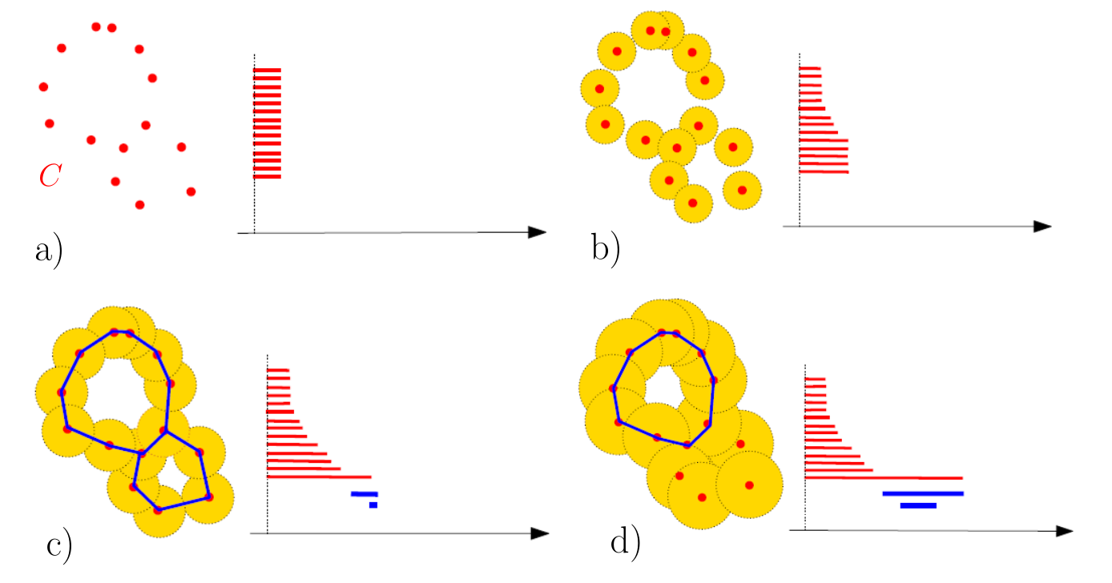
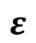

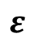

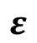


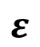
Topological data analysis (TDA)
Persistent barcode
$0$
$$ε$$
$0$
$$ε$$
$0$
$$ε$$
$0$
$$ε$$
Figures in this slide: Chazal, F., & Michel, B. (2017). An introduction to Topological Data Analysis: fundamental and practical aspects for data scientists. arXiv preprint arXiv:1710.04019.

Slide 12




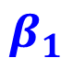
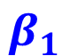
Topological data analysis (TDA)
Persistent barcode
Point cloud
$$β_{0}$$
$$β_{0}$$
$0$
$$ε$$
$0$
$$ε$$
$$β_{0}$$
$$β_{0}$$
$$β_{1}$$
$$β_{1}$$
$0$
$$ε$$
$0$
$$ε$$
Figures in this slide: Chazal, F., & Michel, B. (2017). An introduction to Topological Data Analysis: fundamental and practical aspects for data scientists. arXiv preprint arXiv:1710.04019.

Slide 13
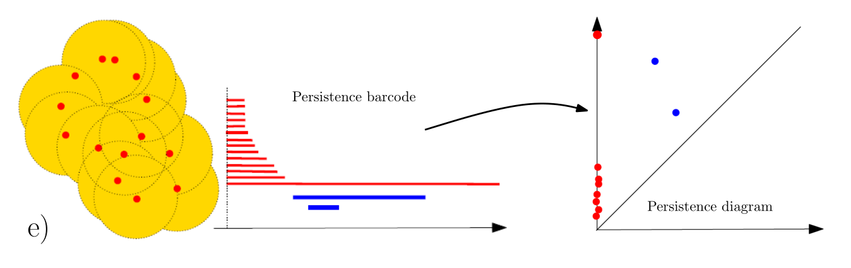
Topological data analysis (TDA)
Persistence diagram
Figures in this slide: Chazal, F., & Michel, B. (2017). An introduction to Topological Data Analysis: fundamental and practical aspects for data scientists. arXiv preprint arXiv:1710.04019.

Slide 14
Topological data analysis (TDA)
Persistence diagram
Birth
Death
Figures in this slide: Chazal, F., & Michel, B. (2017). An introduction to Topological Data Analysis: fundamental and practical aspects for data scientists. arXiv preprint arXiv:1710.04019.

Slide 15
Topological data analysis (TDA)
(Birth , Death)
Persistence diagram
Death
Birth
Death
Birth
Figures in this slide: Chazal, F., & Michel, B. (2017). An introduction to Topological Data Analysis: fundamental and practical aspects for data scientists. arXiv preprint arXiv:1710.04019.

Slide 16
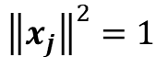
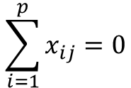
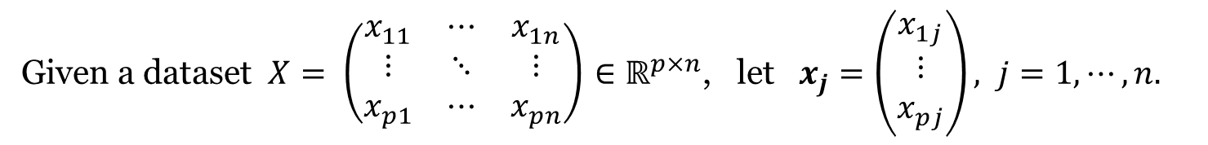
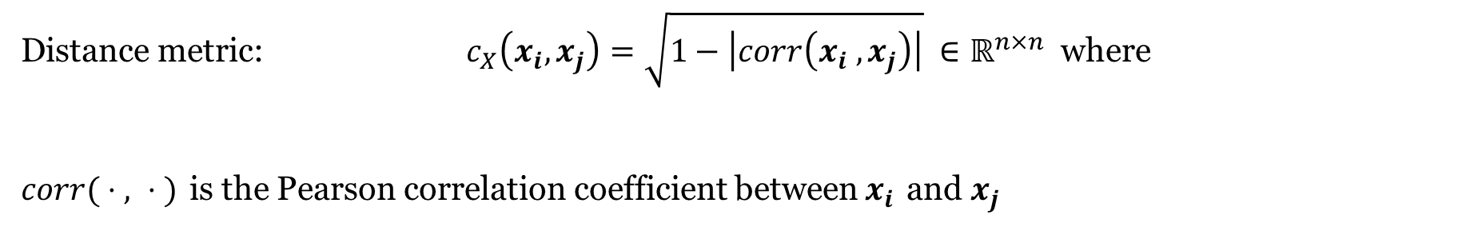
Method: point cloud
Given a dataset $X= \left(\begin{matrix}x_{11} & ⋯ & x_{1n} \\ ⋮ & ⋱ & ⋮ \\ x_{p1} & ⋯ & x_{pn}\end{matrix}\right)$ $∈ℝ^{p×n}$, let $x_{j}=\left(\begin{matrix}x_{1j} \\ ⋮ \\ x_{pj}\end{matrix}\right), j=1,⋯,n.$
Assume that $x_{j}$ are centered and normalized:
$$\sum_{i=1}^{p}{x_{ij}}=0$$
$${\left\|x_{j}\right\|}^{2}=1$$
Distance metric: $c_{X}\left(x_{i},x_{j}\right)=\sqrt{1−\left|corr\left(x_{i} , x_{j}\right)\right|} ∈ℝ^{n×n}$ where
$corr( ⋅ , ⋅ )$ is the Pearson correlation coefficient between $x_{i}$ and $x_{j}$
(point cloud)

Slide 17

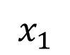
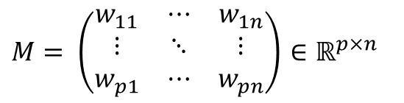
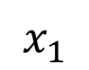
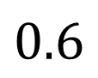


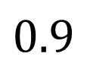
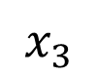
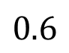
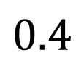
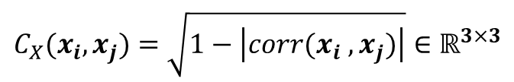
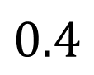
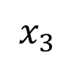
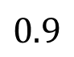
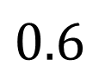
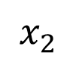
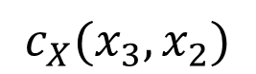

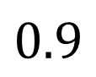
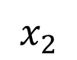
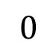
Method: point cloud
Heatmap :
Data visualization technique with colored representation based on matrix element value.
$$C_{X}(x_{i},x_{j})=\sqrt{1−\left|corr(x_{i} , x_{j})\right|}∈ℝ^{3×3}$$
heatmap
representation
$M= \left(\begin{matrix}w_{11} & ⋯ & w_{1n} \\ ⋮ & ⋱ & ⋮ \\ w_{p1} & ⋯ & w_{pn}\end{matrix}\right)$ $∈ℝ^{p×n}$
$$x_{1}$$
$$x_{2}$$
$$x_{3}$$
$$0.9$$
$$x_{1}$$
$$0$$
$$0.6$$
$$0.4$$
$$w_{ij}$$
(sorted)
$$x_{2}$$
$$0.6$$
$$0$$
$$0.9$$
$$0.6$$
Heatmap
$$x_{3}$$
$$0.4$$
$$0.9$$
$$0$$
$$0$$
$$c_{X}(x_{3},x_{2})$$

Slide 18
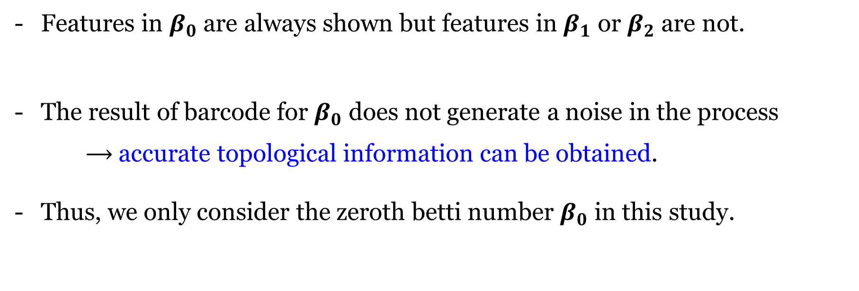
Method: barcode
Features in $β_{0}$ are always shown but features in $β_{1}$ or $β_{2}$ are not.
The result of barcode for $β_{0}$ does not generate a noise in the process
accurate topological information can be obtained.
Thus, we only consider the zeroth betti number $β_{0}$ in this study.

Slide 19

Method: barcode
In order to obtain the more accurate results for $β_{0}$,
we consider geometric information of $β_{0}$, with a topological information.
We use the dendrogram in this study as geometric information of $β_{0}$ as
Lee et al., Persistent brain network homology from the perspective of dendrogram,
IEEE transactions on medical imaging, 2012.

Slide 20















Method: dendrogram
Dendrogram :
The diagram that shows the hierarchical relationship between objects such as stem of a tree.
$$((A⋃B)⋃C)⋃D$$
$$((A⋃B)⋃C)⋃D$$
$$(A⋃B)⋃C$$
$$(A⋃B)⋃C$$
$$C$$
$$A⋃B$$
$$A⋃B$$
$$D$$
$$A$$
$$B$$
$$A$$
$$B$$
$$C$$
$$D$$

Slide 21







Method: barcode and dendrogram
$$ε=0$$
$$ε=t_{1}$$
$$ε=t_{2}$$
$$ε=t_{3}$$
$$ε=t_{4}$$
Reference & Figure : Lee, H., Kang, H., Chung, M. K., Kim, B. N., & Lee, D. S. (2012). Persistent brain network homology from the perspective of dendrogram. IEEE transactions on medical imaging, 31(12), 2267-2277.

Slide 22












Method: barcode and dendrogram
$$ε=0$$
$$ε=t_{1}$$
$$ε=t_{2}$$
$$ε=t_{3}$$
$$ε=t_{4}$$
Barcode for $β_{0}$
Dendrogram
$$β_{0}$$
$$0$$
$$t_{1}$$
$$t_{2}$$
$$t_{3}$$
$$0$$
$$t_{1}$$
$$t_{2}$$
$$t_{3}$$
Reference & Figure : Lee, H., Kang, H., Chung, M. K., Kim, B. N., & Lee, D. S. (2012). Persistent brain network homology from the perspective of dendrogram. IEEE transactions on medical imaging, 31(12), 2267-2277.

Slide 23



Method: comparison between subjects
For each dataset of subject $X_{i} , i=1,⋯n,$ we obtain $d_{X_{i}}^{}$ as follows.
$$d_{X_{i}}^{}$$
Save the matrix form
Reference & Figure : Lee, H., Chung, M. K., Kang, H., Kim, B. N., & Lee, D. S. (2011, September). Computing the shape of brain networks using graph filtration and Gromov-Hausdorff metric. In International Conference on Medical Image Computing and Computer-Assisted Intervention (pp. 302-309). Springer, Berlin, Heidelberg.

Slide 24
Method: comparison between subjects
We want to compute the distance between two subjects $X_{i}$, $X_{j}∈ℝ^{p×n}$.
Gromov-Hausdorff distance (GH distance)
$$d_{GH}\left(X_{i}, X_{j}\right)=\frac{1}{2}\max_{∀i,j}\left|{d_{X}}_{i}−{d_{X}}_{j} \right|$$
${d_{X}}_{i} ,{d_{X}}_{j}∈ℝ^{n×n}$ : the matrices which are converted subjects for $X_{i}$, $X_{j}$.
Reference: Lee, H., Chung, M. K., Kang, H., Kim, B. N., & Lee, D. S. (2011, September). Computing the shape of brain networks using graph filtration and Gromov-Hausdorff metric. In International Conference on Medical Image Computing and Computer-Assisted Intervention (pp. 302-309). Springer, Berlin, Heidelberg.

Slide 25


Method: multidimensional scaling (MDS)
A technique that represents proximities among objects as distances among points in a low-dimensional space (with given dimensionality).
Input as the distance matrix:
Output as proximities:
Reference: Mair, P., Borg, I., & Rusch, T. (2016). Goodness-of-fit assessment in multidimensional scaling and unfolding. Multivariate behavioral research, 51(6), 772-789..
Figure: http://www.analytictech.com/borgatti/mds.htm

Slide 26


Application
Dataset: biomechanical data (kinematics)
- Joint angle measurement dataset
- Data size : (100 times) $×$ (31 variables) $×$ (9 subjects)
10 joint angles
(x-axis)
+
10 joint angles
(y-axis)
+
10 joint angles
(z-axis)
+
X factor
Figures in this slide: https://musculoskeletalkey.com/biomechanics-2/

Slide 27


Point cloud
Define a point cloud.
For the subject $X_{i} , i=1,⋯9,$
$$c_{X_{i}}=\sqrt{1−\left|corr(X_{i})\right|} ∈ℝ^{31×31}$$

Slide 28










Barcode
$β_{0}$
$β_{0}$
$β_{1}$
$β_{1}$
$β_{2}$
$β_{2}$
value of $ε$
value of $ε$

Slide 29





Persistence diagram
$β_{0}$
$β_{1}$
$β_{2}$
Subject 3
Subject 6

Slide 30




Dendrogram
value of $ε$
value of $ε$
value of $ε$

Slide 31



Multidimensional scaling
Input distance matrix:
Output:
Multidimensional scaling result
The indices 1 ~ 9 = subject number 1 ~ 9

Slide 32

Summary
Overall, there is a distinct difference in $β_{0}$ between subject.
Especially in $β_{0}$, the connectivity of subject 3,6, and 9 is slower than others.
As a result of the MDS, all the subjects were separated by 3 partial groups.
The subject 3 had the largest dissimilarity than others.
It is necessary to find the key variables representing difference among subjects

Slide 33
Thank you ! Contact me : sangmanjung@khu.ac.kr

